Slide 1
Introduction to programming
Constants, variables and Data type

Slide 2
Introduction
Computer performs data processing by executing various sequence of instructions called program.
These instruction are formed by the combination of certain words and symbols in a proper sequence or correct pattern.
These patterns or rules are called syntax or grammar of the programming language.
Each programming languages have their own syntax or rules.

Slide 3
Character Set
The set of characters that are used to form words, numbers and expression in C. The character set are grouped in 4 categories:
Letters/alphabets: A..Z ,a..z
Digits: 0..9
Special character: ,.;!”%^&*() etc
White space: The blank space in between

Slide 4
Keywords
There are certain words reserved for doing specific task, these words are known as reserved word or keywords.
These words are predefined and always written in lower case or small letter.
All the keywords have specific meaning and these meanings cannot be changed.
These keywords cannot be used as a variable name as it assigned with fixed meaning.
Examples: int, short, signed, unsigned, default, volatile, float, long, double, break, continue, typedef, static, do, for, union, return, while, do, extern, register, enum, case, goto, struct, char, auto, const etc.

Slide 5
Data types
There are various types of data.
Depending upon the type, they are represented differently within the computer memory.
Integer type (int)
Floating point type (float)
Double precision floating point type (double)
Character type (char)
Void type (void)

Slide 6
Integer Type( int)
Integer are whole numbers i.e. non fractional numbers.
Integer requires 16bit of storage.
Integer in c is further categorised as-
Integer (int)
Short integer (short int)
Long integer (long int)

Slide 7
Floating point types (float)
They are fractional numbers.
It reserves 4 bytes in memory.
It represents fractional number of the range-
1.2*10^-38 to +3.4 * 10^(+38)

Slide 8
Double Precision Floating Point Type (double)
Double data type holds 64bitts/8 bytes of memory.
Which means it can hold more data number or precise data than the float data type.

Slide 9
Character Type(char)
A single character can be defined as character data type.
Characters are stored in 8bits/1bytes of memory.
In character data type each character are represented by an ASCII(American Standard Code for Information Interchange).
ASCII- A is represented by 65.. Z is represented by 90
A is represented by 97 .. z is represented by 122.

Slide 10
Data type with format specifier
Data type | keyword | format
integer | int | %d or %i
float | float | %f
double | double | %lf
character | char | %c

Slide 11
Void Data type
Void data types has no value.
Its usually to the function which does not return any values.
You will study in details about void while studying about function.

Slide 12
Character constant
A character constant is a single character alphabet, a digit or a special symbol enclosed within a single quote.
Example1: ‘a’ – valid character constant while ‘aa’ invalid character constant.
Example 2: int a= 5; char b= ‘5’;
Here in the above example a and b are not equal.

Slide 13
Think1:What will be the output
#include <stdio.h>
#include <conio.h>
int main()
{
char a='a';
char b='b';//98
char c= '5';//53
int i= c+10;
printf("lets print the values now: \n");
printf("%c \n",a);
printf("%d \n",b);
printf("%d \n",c);
printf("%d \n",i);
return 0;
}

Slide 14
Variables
A variable is a symbolic name which is used to store data. What kind of variables to be stored in the name depends upon the type of variables.
Variables name may consists of letters, numbers , underscores.
However it cannot start with numbers, symbols and should not contain any white spaces.

Slide 15
Symbolic constant
Constants are defined in the beginning of the program.
Generally these are defined in the capital letter. they have same rules for the form of variable names.
Example: #define PI 3.14
#define SQUARE 4
You can also use the term const to define the constant value. the const does not have to be define like #define as preprocessor derectives, it can be done in general while the program is being executed.

Slide 16
Example of #define
#include <stdio.h>
#include <conio.h>
#define PI 3.14
int main()
{
float area;
int radius= 5;
area= PI *radius* radius;
printf("The area of the circle is\n %f",area);
return 0;
}

Slide 17
Example of const
#include <stdio.h>
int main()
{
const int LENGTH = 10;
const int WIDTH = 5;
int area;
area = LENGTH * WIDTH;
printf("value of area : %d", area);
return 0;
}

Slide 18
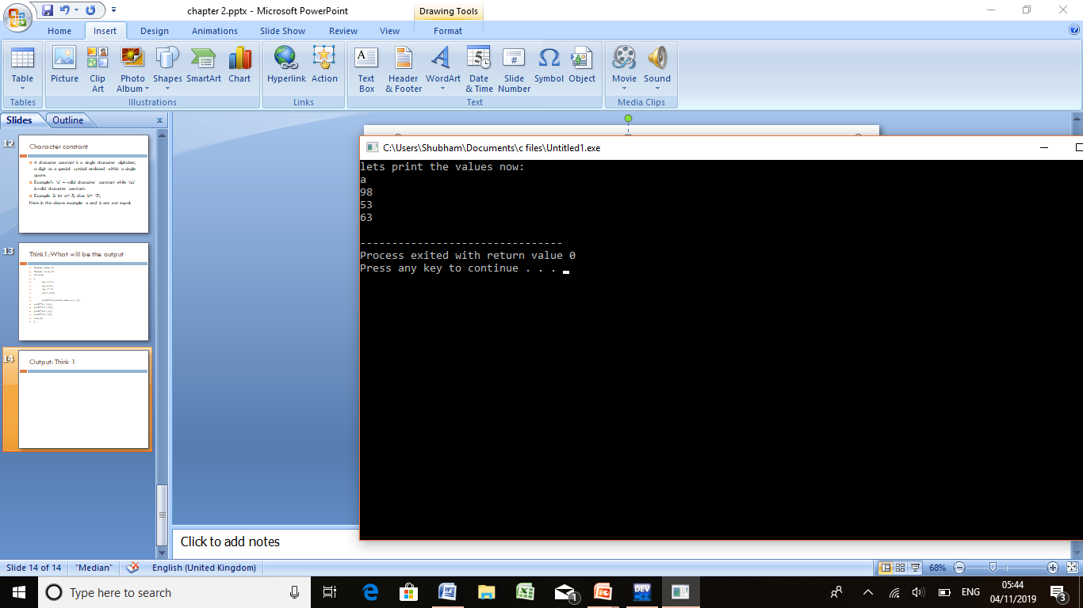
Output: Think 1

